Slide 1


DYNAMIC TECHNIQUES

Slide 2
STATIC TESTING
Phases of formal review
Planning
Kick off
Preparation
Review meeting
Rework
Follow up
Roles
The moderator
The author
The scribe/ recoder
The reviewer
The manager
Types of review
Walkthrough
Technical review
Inspection

Slide 3
AGENDA
TEST DEVELOPMENT PROCESS (K3)
THE CATEGORIES OF TEST DESIGN TECHNIQUES (K2)
BLACKBOX TECHNIQUES (K3)
WHITEBOX TECHNIQUES (K4)
EXPERIENCE-BASED TECHNIQUES (K2)
CHOOSING DESIGN TECHNIQUES (K2)
Notes:
Thời lượng đề xuất:
Mục 1, 2: 90’ (2 tiết)
Mục 3: Mỗi category (blackbox/whitebox/experience-based) là 90’ (2 tiết*3=6 tiết). Phần blackbox và whitebox có thể dành nhiều thời gian hơn, có thể dùng tới 5 tiết. Hai mục còn lại (experience-base technique và choosing technique) chỉ cần nói trong 1 tiết là đủ.

Slide 4

1. TEST DEVELOPEMENT PROCESS (1/4)
Test analysis: identifying test conditions
Test design: specifying test cases
Test implementation: specifying test procedures or scripts
Notes:
Document:
Test conditions are documented in a Test Design Specification.
Test cases are documented in a Test Case Specification.
Test procedures are documented (as you may expect) in a Test Procedure Specification (also known as a test script or a manual test script).

Slide 5
1. TEST DEVELOPEMENT PROCESS (1/4)
Test analysis: identifying test conditions
Is the process of looking at something that can be used to derive test information.
Look at information from test basis
Should have a traceability
Can identify test data
Notes:
A test condition is simply something that we could test.
Test basis: includes all documents such as SRS, system requirement, a technical specification, the code itself (for structural testing), or a business process and an experienced user's knowledge of the system.
Test conditions should be able to be linked back to their sources in the test basis - this is called traceability.

Slide 6
1. TEST DEVELOPEMENT PROCESS (3/4)
Test design: specifying test cases
Create and specify test cases and test data
A test case consists
A set of input values
Execution preconditions
Expected results
Execution post conditions
And covered test objective(s)/ test conditions
Notes:
In order to know what the system should do, we need to have a source of information about the correct behavior of the system - this is called an 'oracle' or a test oracle.
Expected results include information displayed on a screen in response to an input, but they also include changes to data and/or states, and any other consequences of the test (e.g. a letter to be printed overnight).

Slide 7
1. TEST DEVELOPEMENT PROCESS (4/4)
Test implementation: specifying test procedures or scripts
Develop, implement, priority, organize test case in Test Procedure Specification
Create a execution test schedule

Slide 8
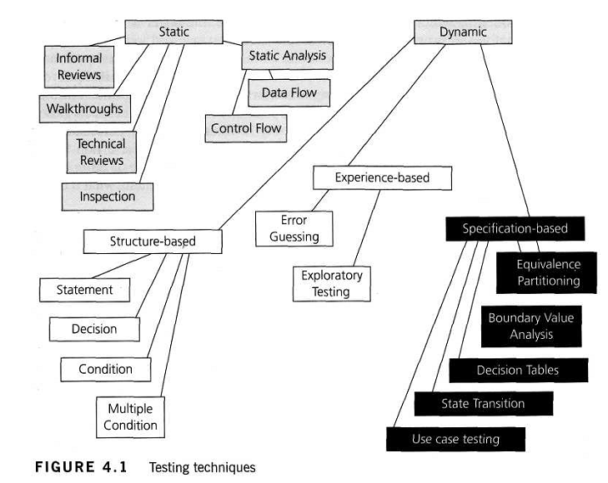
2. THE CATEGORIES OF TEST DESIGN TECHNIQUES

Slide 9
2. THE CATEGORIES OF TEST DESIGN TECHNIQUES
Black-box test design techniques
Testing without knowledge about how the system do, only concentrate to what the system do
To include both functional and non-functional testing.

Slide 10
2. THE CATEGORIES OF TEST DESIGN TECHNIQUES
Black-box test design techniques
Typical techniques:
Equivalence partitioning.
Boundary value analysis.
Decision tables.
State transition testing.
Use Case Testing
Notes:
Common characteris của 2 phần này đâu?

Slide 11
2. THE CATEGORIES OF TEST DESIGN TECHNIQUES
White-box testing techniques
To run on an application with the knowledge of the internal working of the code base
Typical techniques:
Statement Testing and Coverage
Decision Testing and Coverage
Other Structure-based Techniques

Slide 12
2. THE CATEGORIES OF TEST DESIGN TECHNIQUES
Experience-based test design techniques:
- The knowledge and experience of people are used to derive the test cases
- The knowledge of testers, developers, users and other stakeholders about the software, its usage and its environment is one source of information
- Knowledge about likely defects and their distribution is another source of information

Slide 13
3. BLACK-BOX TECHNIQUES
Equivalence partitioning.
Boundary value analysis.
Decision tables.
State transition testing.
Use Case Testing

Slide 14
3.1. EQUIVALENCE PARTITIONING.
What:
A technique that divides the input data of a software unit into partitions of data from which test cases can be derived.
How:
Select each a input value in each partition
Where:
Can be applied at all test levels.

Slide 15
3.1. EQUIVALENCE PARTITIONING.
Example:
A savings account in a bank earns a different rate of interest depending on the balance in the account
If a balance in the range $0 up to $100 has a 3% interest rat
A balance over $100 and up to $1000 has a 5% interest rate
Balances of $1000 and over have a 7% interest rate
Notes:
We would initially identify three valid equivalence partitions and one invalid partition

Slide 16
3.2. BOUNDARY VALUE ANALYSIS
The tests are designed to include representatives of boundary values. Values on the minimum and maximum edges of an equivalence partition are tested.
Frequently exercised in test cases
Can be applied at all test levels.
Relatively easy to apply and its defect finding capability is high

Slide 17

3.2. BOUNDARY VALUE ANALYSIS
Example:
- To apply boundary value analysis, we will take the minimum and maximum (boundary) values from the valid partition (1 and 99 in this case) together with the number of copies to be made, from 1 to 99.
- The first or last value respectively in each of the invalid partitions adjacent to the valid partition (0 and 100 in this case).

Slide 18
3.3. DECISION TABLE
A decision table is a good way to deal with combinations of input data.
Also known as 'cause-effect table'.
Using decision table to design test:
Step 1: Identify input condition
Step 2: Identify all of the combinations of "True" and "False" of each input condition.
Step 3: Identify the correct out come for each combination

Slide 19
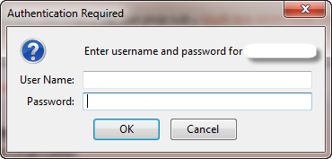
3.3. DECISION TABLE
Example:
Trên màn hình đăng nhập, có 2 thông tin cần đưa vào là Tên đăng nhập và mật khẩu, chỉ thực hiện đăng nhập thành công nếu nhập đúng cả Tên đăng nhập và mật khẩu, các trường hợp còn lại sẽ hiển thị thông báo “Nhập không chính xác, yêu cầu nhập lại”

Slide 20
3.3. DECISION TABLE
Example:
Step 1: Xác định các điều kiện đầu vào
Số cột giá trị tính = 2 mũ N (N: số đầu vào)
Đầu vào | Giá trị 1 | Giá trị 2 | Giá trị 3 | Giá trị 4
Tên đăng nhập
Mật khẩu

Slide 21
3.3. DECISION TABLE
Example:
Step 2: Nhập các giá trị có thể xảy ra
Mỗi giá trị đầu vào sẽ có 1 nửa là T, 1 nửa F
Đầu vào | Giá trị 1 | Giá trị 2 | Giá trị 3 | Giá trị 4
Tên đăng nhập | T | T | F | F
Mật khẩu | T | F | T | F

Slide 22
3.3. DECISION TABLE
Example:
Step 3: Xác định các giá trị đầu ra căn cứ đầu bài.
Đầu vào | Giá trị 1 | Giá trị 2 | Giá trị 3 | Giá trị 4
Tên đăng nhập | T | T | F | F
Mật khẩu | T | F | T | F
Đầu ra
Thông báo | Thành công | Chưa nhập pass | Chưa nhập tên | Chưa nhập pass hoặc tên

Slide 23
3.3. DECISION TABLE
Exercise:
We have the following requirement for credit card management system:
If you are a new customer opening a credit card account, you will get a 15% discount on all your purchases today.
If you are an existing customer and you hold a loyalty card, you get a 10%discount.
If you have a coupon, you can get 20% off today (but it can't be used with the 'new customer' discount).
Discount amounts are added, if applicable
Requirement: Design test for this application using decision table (10 minutes).

Slide 24
3.3. DECISION TABLE
Decision table
Can use Yes/ No = True/ False
Conditions | Rule 1 | Rule 2 | Rule 3 | Rule 4 | Rule 5 | Rule 6 | Rule 7 | Rule 8
New customer (15%) | T | T | T | T | F | F | F | F
Loyalty card (10%) | T | T | F | F | T | T | F | F
Coupon (20%) | T | F | T | F | T | F | T | F
Actions
Discount (%) | X | X | 20 | 15 | 30 | 10 | 20 | 0

Slide 25
3.3. DECISION TABLE
Decision table can be described as a cause-effect table:
Cause =condition
Effect= action = expected results
If all causes are simply Y/N values: Number of effect = 2^{number of causes}
Cause | Value | Comb1 | Comb2 | Comb3 | Comb4 | Comb5 | Comb6
Cause 1 | V11, V12 | V11 | V11 | V11 | V12 | V12 | V12
Cause 2 | V21 | V21 | V21 | V21 | V21 | V21 | V21
Cause 3 | V31, V32, V33 | V31 | V32 | V33 | V31 | V32 | V33
Effect
Effect 1 | x |  | x | x |  | x
Effect 2 |  | x |  |  | x |  | x

Slide 26
3.3. DECISION TABLE
Note:
If all causes are simply Y/N values: Number of effect = 2^{number of causes}
For example:
If 1 cause with 3 values and 3 with 2: No. of effect=3¹ * 2³ = 24
Or, use the Values column and multiply each value down the column, e.g. 3*2*2*2=24

Slide 27
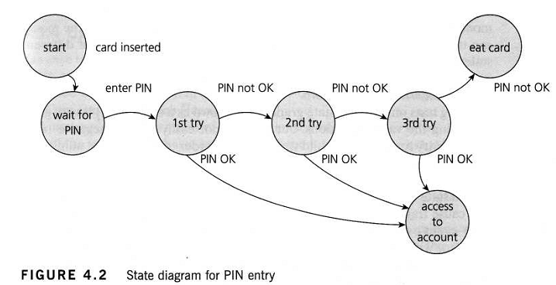
3.4. STATE TRANSITION TESTING
State transition testing is used where some aspect of the system can be described as a 'finite state machine'
Example: State diagram for PIN entry (ATM).

Slide 28
3.4. STATE TRANSITION TESTING
State transition testing
A system has a different response depending on current conditions or previous history (its state).
It allows the tester to view the software in terms of :
its states
transitions between states
the inputs or events that trigger state changes (transitions)
the actions which may result from those transitions.
A state table shows the relationship between the states and inputs, and can highlight possible transitions that are invalid.

Slide 29
3.4. STATE TRANSITION TESTING
A state transition model has four basic parts
The states that the software may occupy (open/closed or funded/insufficient funds);
The transitions from one state to another (not all transitions are allowed);
The events that cause a transition (closing a file or withdrawing money);
The actions that result from a transition (an error message or being given your cash).

Slide 30
3.5. USE CASE TESTING
A use case describes interactions between actors, including users and the system
Each use case:
has preconditions which need to be met for a use case to work successfully.
terminates with post conditions which are the observable results and final state of the system after the use case has been completed.

Slide 31
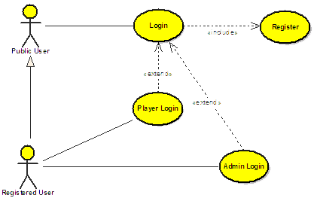
3.5. USE CASE TESTING
Use cases are very useful for designing acceptance tests with customer/user participation
Designing test cases from use cases may be combined with other specification-based test techniques.

Slide 32
4. WHITE-BOX TECHNIQUES
Introduction
Statement testing and coverage
Decision testing and coverage
Other structure-based techniques

Slide 33

4.1. INTRODUCTION
White-box techniques serve two purposes:
Test coverage measurement
Structural test case design
Test coverage measures the amount of testing performed by a set of tests:
100% coverage does not mean 100% tested

Slide 34
4.1. INTRODUCTION
Drawbacks:
it measures coverage of what has been written, i.e. the code itself; it cannot say anything about the software that has not been written

Slide 35
4.1. INTRODUCTION
Types of coverage
EP: percentage of equivalence partitions exercised
BVA: percentage of boundaries exercised
Decision tables: percentage of business rules or decision table columns tested
State transition testing: there are a number of possible coverage measures:
Percentage of states visited
Percentage of (valid) transitions exercised

Slide 36

4.2. STATEMENT TESTING AND COVERAGE
Statement coverage is the assessment of the percentage of executable statements that have been exercised by a test case suite.

Slide 37
4.2. STATEMENT TESTING AND COVERAGE
Example 1:
Read P
Read Q
IF P+Q > 100 THEN
Print “Large”
ENDIF
If P > 50 THEN
Print “P Large”
To have statement coverage for this code, how many tests are required ?
Notes:
Only one: P=60, Q=50

Slide 38
4.2. STATEMENT TESTING AND COVERAGE
Example 2:
1 READ A
2 READ B
3 C =A + 2 *B
4 IF C> 50 THEN
5 PRINT large C
6 ENDIF
Calculate the statement coverage of the following test:
TEST_001: A=0; B=25
TEST_002: A=40; B=10
Notes:
TEST_001: 5/6=83%
TEST_002: 100%

Slide 39

4.3. DECISION TESTING AND COVERAGE
A decision is an IF statement, a loop control statement (e.g. DO-WHILE or REPEAT-UNTIL), or a CASE statement, where there are two or more possible exits/outcomes from the statement
Decision coverage:
Note:100% decision coverage guarantees 100% statement coverage, but not vice versa!
Notes:
TEST_001: 5/6=83%
TEST_002: 100%

Slide 40
4.3. DECISION TESTING AND COVERAGE
Example:
The following test has statement coverage=100% :
TEST_001: A=10; B=20
BUT IT DOES NOT HAVE DECISION COVERAGE=100%
1 READ A
2 READ B
3 C = A – 2*B
4 IF C < 0 THEN
PRINT”C negative”
ENDIF
Notes:
TEST_001: 5/6=83%
TEST_002: 100%

Slide 41
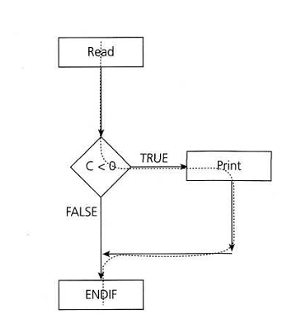
4.3. DECISION TESTING AND COVERAGE
TEST_001 does not cover the "FALSE" outcome:

Slide 42
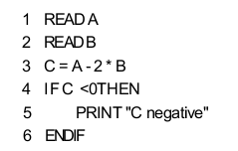
4.3. DECISION TESTING AND COVERAGE
To have decision coverage=100% on this code:
We need 2 test cases:
TEST_001: A=10; B=20
TEST_002: A=10; B=5

Slide 43
5. EXPERIENCE-BASED TECHNIQUES
Error guessing:
No rule, totally depends on experience of tester
Think of situations in which the software may not be able to cope: divide by 0, blank input, empty files and the wrong kind of data

Slide 44
5. EXPERIENCE-BASED TECHNIQUES
Exploratory testing:
To be concurrent test design, test execution, test logging and learning, based on a test charter containing test objectives, and carried out within time-boxes

Slide 45
6. CHOOSING A TEST TECHNIQUE
Depends on a few of internal factors:
Models used
Tester knowledge & experience
Likely defects
Test objective
Documentation
Life cycle model

Slide 46
6. CHOOSING A TEST TECHNIQUE
And external factors:
Risk
Customer or contractual requirements
Type of system
Regulatory requirements
Time and budget

Slide 47
SUMMARY
To have knowledge about: test development process, dynamic techniques
Understand kind of dynamic techniques: black-box testing, white-box testing, experience-based testing
To know how to choose a test techniques match with project

Slide 48
Q&A
?

